Slide 1
MOT1421: Economic Foundations Week 5: Neoclassical Macro-Economics
Key assumptions of the neo-classical macro model:
In-built tendency toward full employment of labour & capital
Markets clear by means of the price mechanism; the model includes a labour market; a capital market; a market for goods & services; a loanable funds market; and a money market
Consumers are utility-maximisers and firms are profit-maximisers
Money is ‘neutral’; the classical dichotomy between the ‘real’ economy and the ‘financial’ economy holds true
Fiscal policy is not effective, because it leads to crowding out
Monetary policy has the task to contain/stabilise inflation

Slide 2
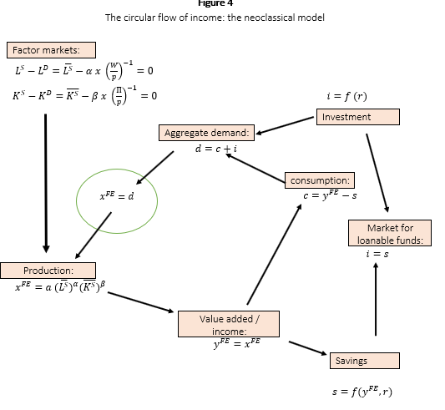
MOT1421: Economic Foundations Week 5:
The neoclassical
circular flow of income
We will 1st look at the
Factor markets

Slide 3
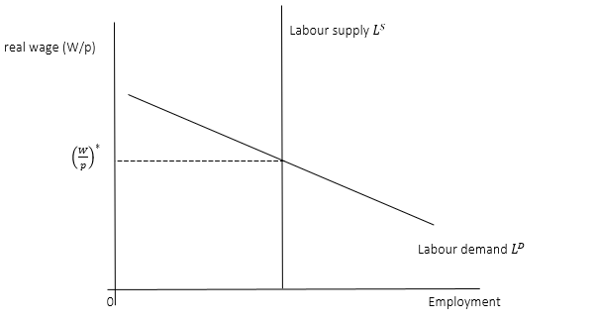
MOT1421: Economic Foundations Week 5: Neoclassical Macro-Economics
Factor markets:
Labour market
Price-clearing;
the price is (W/p)

Slide 4
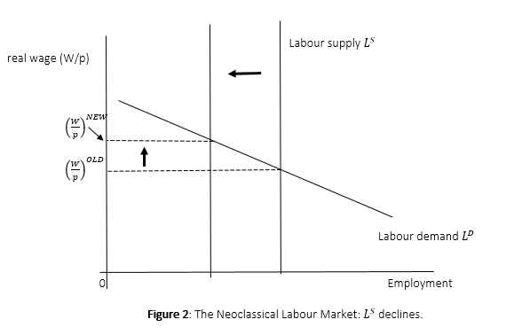
MOT1421: Economic Foundations Week 5: Neoclassical Macro-Economics
Factor markets:
Labour market:
Ls declines ->
equilibrium (W/p)
increases

Slide 5
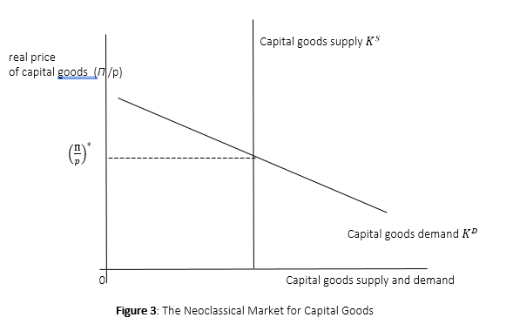
MOT1421: Economic Foundations Week 5: Neoclassical Macro-Economics
Factor markets:
Capital market
Capital = machines

Slide 6
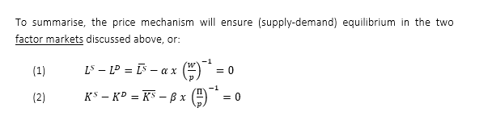
MOT1421: Economic Foundations Week 5: Neoclassical Macro-Economics
Price-clearing in factor markets ensures full employment of L and K:

Slide 7

MOT1421: Economic Foundations Week 5: Neoclassical Macro-Economics
Production:
Production -> income generation (wages + profits) ->
Income is partly saved (S) and partly consumed (C)
Savings constitute a leakage from the circular flow of income
Consumption -> demand for goods & services -> production

Slide 8
MOT1421: Economic Foundations Week 5:
The neoclassical
circular flow of income
(again)
Note: the savings leakage
into the market for
loanable funds

Slide 9
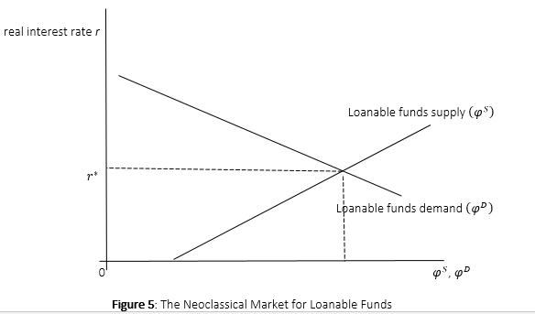
MOT1421: Economic Foundations Week 5: Neoclassical Macro-Economics
The market for loanable funds:
LFs = savings
(deposited in banks)
LFd = investment
(demand for loans)
‘Interest rate’ clearing

Slide 10
MOT1421: Economic Foundations Week 5: Neoclassical Macro-Economics
Full employment is guaranteed in this model,
because of the loanable funds market.
The leakage of income (savings) is “converted” into investment demand via the loanable funds market (banks):
If LFs > LFd, the interest rate goes down until LFs = LFd (equilibrium)
If LFs < LFd, the interest rate goes up until LFs = LFd (equilibrium)

Slide 11
MOT1421: Economic Foundations Week 5: Neoclassical Macro-Economics
Fiscal policy in the neoclassical model:
public spending crowds out private spending
Assume that public investment ig is increased.
As a result, the government deficit goes up and the state has to borrow (from banks) in order to finance the increase in ig.
Result: the demand for loanable funds (LFd) increases.

Slide 12
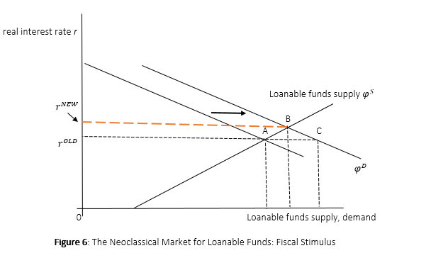
MOT1421: Economic Foundations Week 5:
Fiscal stimulus leads to:
LFd > LFs; increase in r
Higher r lowers private
(business) investment.
Higher r increases private
saving and lowers private
consumption
End result: higher public spending crowds out private spending; fiscal stimulus has no impact on aggregate demand, output, employment.

Slide 13

MOT1421: Economic Foundations Week 5: Neoclassical Macro-Economics
Monetary policy in the neoclassical macro model:
Money supply Ms = Money demand Md = (1/v)*p*y^{FE}
Ms = exogenous (under the control of the central bank)
Md = the transactions demand for money
y^{FE} = full-employment income (see circular flow of income)
Hence, we get: p = (v * Ms)/ y^{FE}
Role for monetary policy:

Slide 14
MOT1421: Economic Foundations Week 5: Neoclassical Macro-Economics
Look at the exercises on:
The labour market (W2-1)
The loanable funds market (W2-2 & W2-3)
Monetary policy (W2-4)

